Slide 1
Stock price analysis of the past to predict the future.
By Ashwini, Ope, Amy, Jaejun, and Gayatri

Slide 2
Analysis and Findings:
We analyzed: FAANGG for Period: January 1,2017 - December 31,2017
Apple(AAPL)
Amazon(AMZN)
Facebook(FB)
Google(GOOG)
Netflix(NFLX) and
Gold(GLD)

Slide 3
Hypothesis: Future stock prices can be predicted from past performance.
Questions considered:
What is the everyday price-change?
What’s the change in stock’s price, and daily return average over time?
Is there any correlation between daily returns of different stocks?
How much value do we put at risk by investing in a particular stock?
How to determine the trend of the stock-price and predict the future?
How do we predict the future price?
Do social media (e.g., Twitter) impact daily changes in stock-price?

Slide 4
Data Exploration and Clean-up :
Source to collect data: google finance, twitter
Problems faced during data gathering:
Yahoo finance website is being deprecated.
Morningstar data was working fine, but was not in the form that we wanted.
So, chose Google Finance as data source.
The data we got was pretty clean.
Notes:
There was a notice of unstable API. So, we matched the numbers with Morningstar data just to check if the numbers are correct. They were same, so, we ended up taking the data from Google.
All rows and columns have data, and, we didn’t have to clean it.

Slide 5
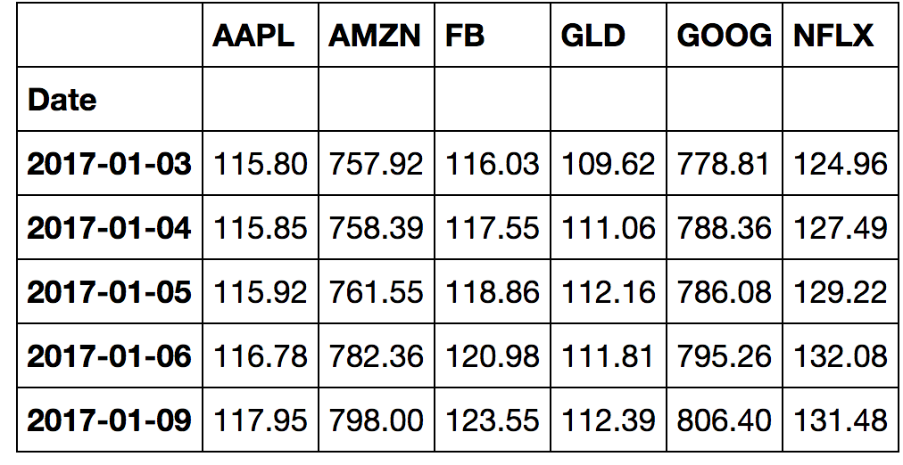
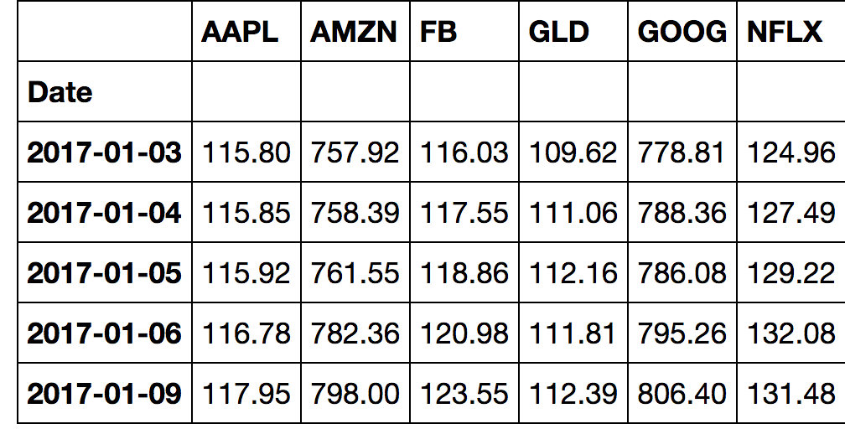
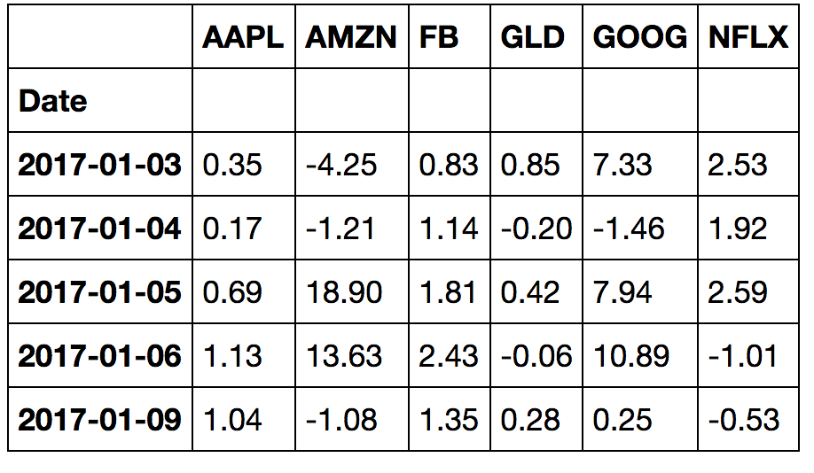
Opening , Closing Prices and the Daily Change tables
Opening Price
Closing Prices
Daily Change

Slide 6
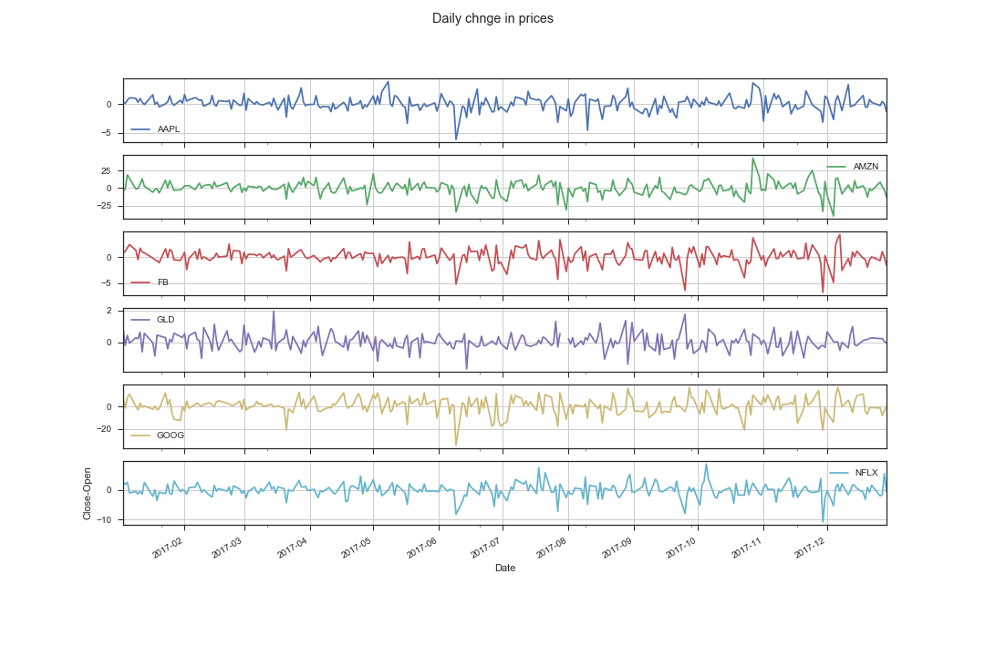
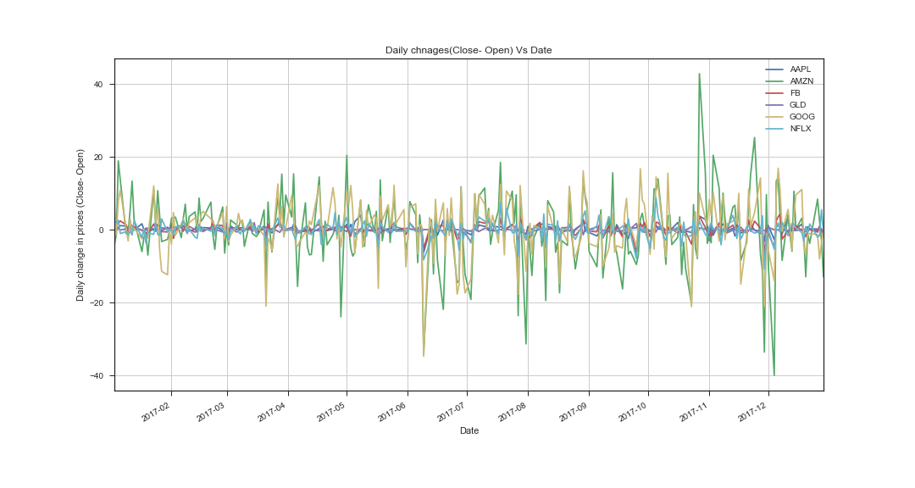
Plots/subplots: Change in prices Vs Date
Conclusion: From the graph, we can noticed that the, Google and Amazon stocks are fluctuating a lot. Amazon goes 40 points higher in the month of Nov2017 and goes down in 40 points in Dec.

Slide 7
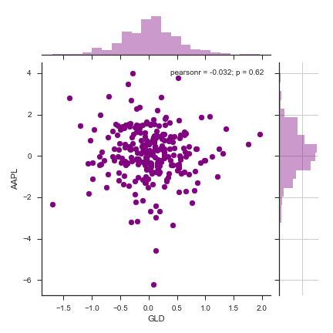
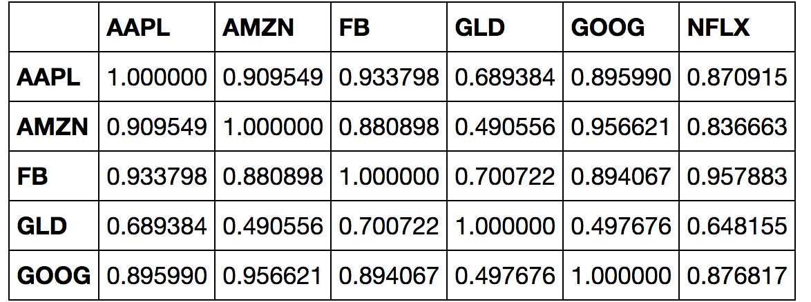
Correlation matrix of all stocks on "Close" prices:

Slide 8
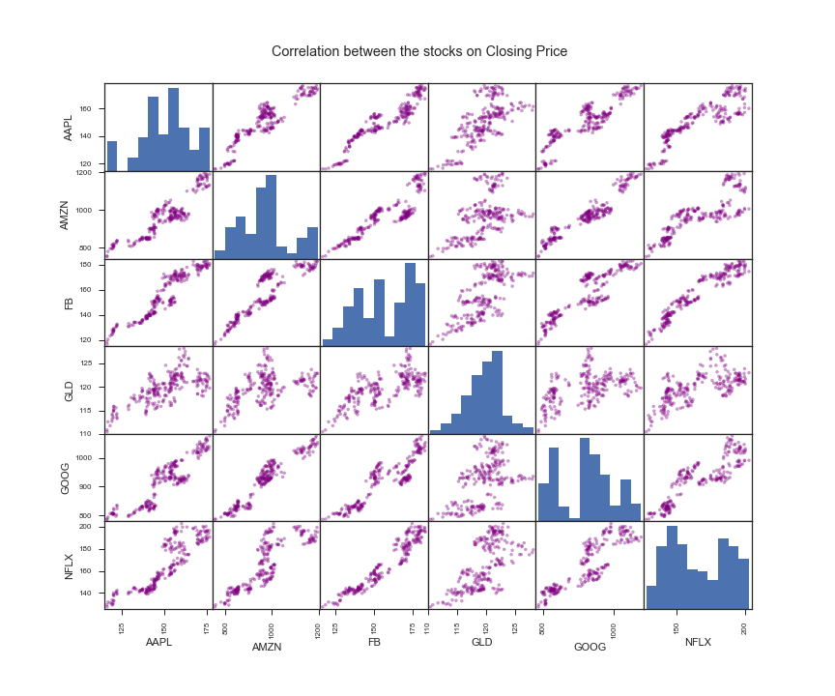
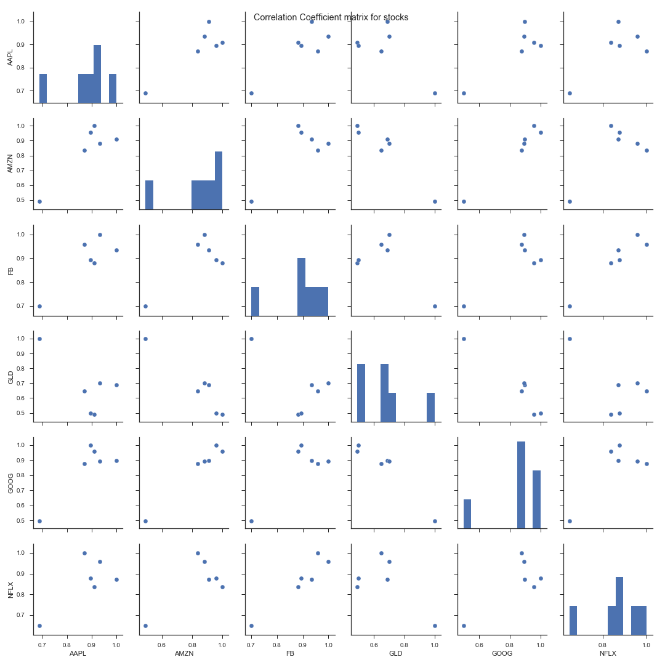
Correlation and correlation coefficient matrix for stocks:

Slide 9
Value at Risk:
“Value at Risk:” Measure of the Risk of loss for an investment.
Estimates how much a set of investments might loose in a set time period in normal market conditions.
Value put at risk by investing in a particular stock:
Calculated by comparing its expected return with the standard deviation of daily returns.
Expected return = Mean of stock’s daily returns.
Notes:
So, let’s look at risk calculations for these stocks. So, what is value at risk? It’s the measure of the Risk of loss for investment. It estimates how much a set of investment might loose in a set time period in normal market conditions.
How much value do we put at risk by investing in a particular stock??
We will use various functions of pandas.

Slide 10
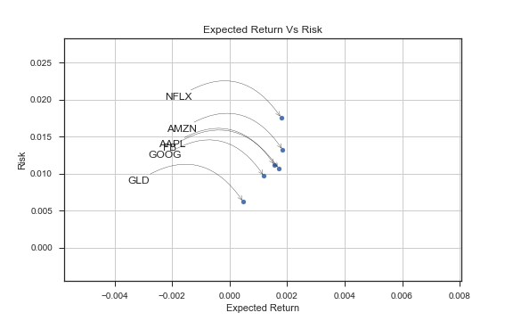
Risk Analysis:
We want high return, low risk stocks.
GLD seems to be the low risk low return socks in the entire list.
GOOG is the low risk low return among tech stocks.
NFLX has the highest return with highest risk.
Risk and returns for FB and AAPL are almost the same.
Notes:
“GOOG is the low risk low return among tech stocks.” This sounds counter intuitive, but, this is only relative to the stocks we have analyzed.

Slide 11
Analysis of AAPL stock

